Slide 1
Data Analysis Using Python
By Shama

Slide 2
Objective
Improve customer experience by analysing the sales data and increasing the revenue.

Slide 3
Process
Load Data
Data Cleaning
Exploratory Data Analytics
Conclusions

Slide 4
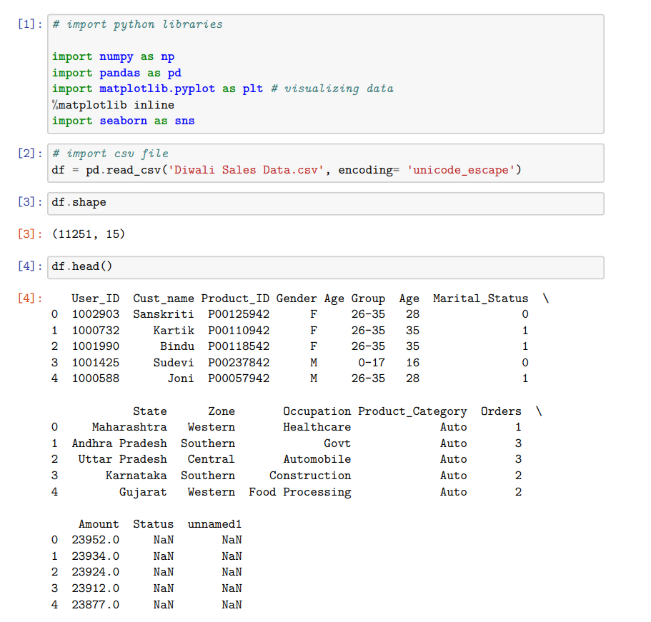
Loading the Data

Slide 5
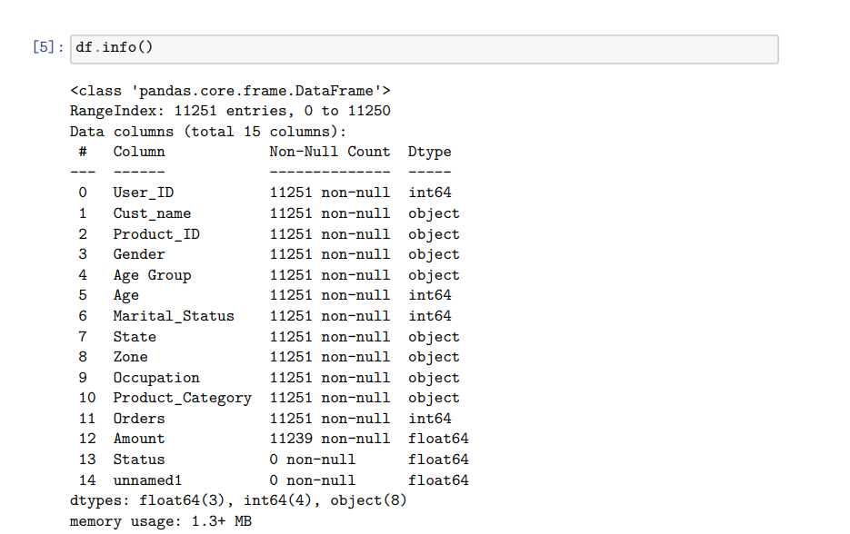

Slide 6
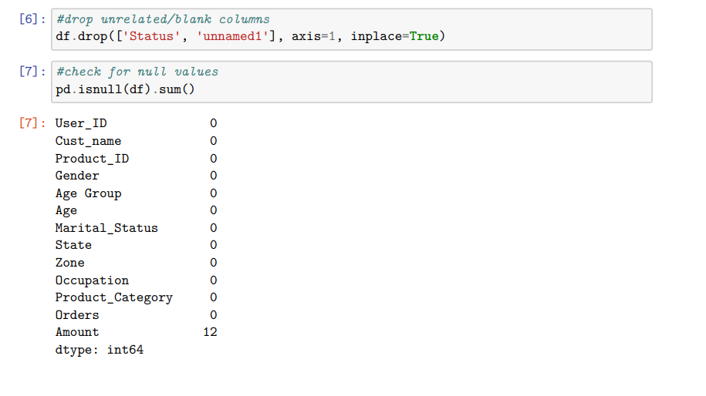
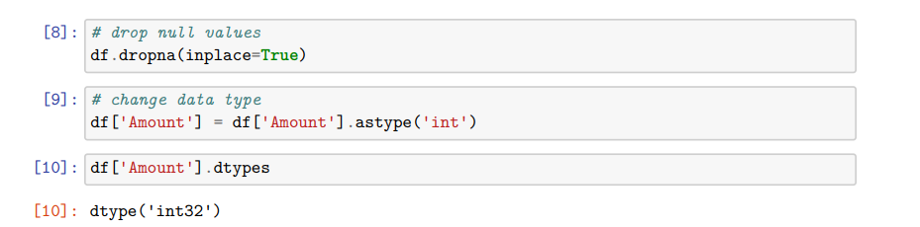
Data Cleaning

Slide 7
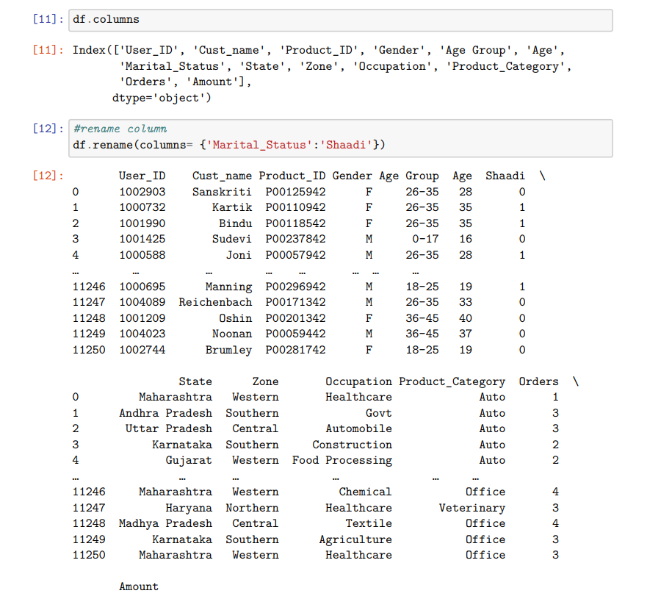

Slide 8
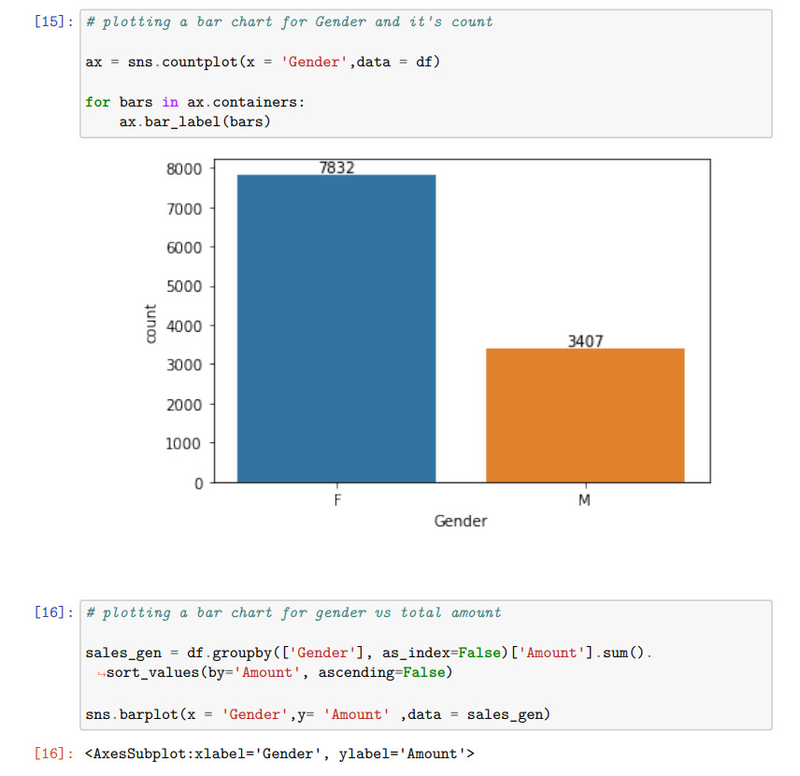
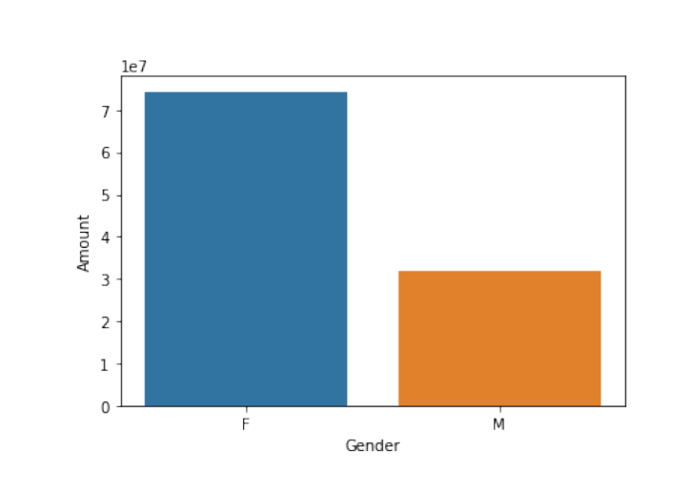
Exploratory Data Analytics Gender

Slide 9
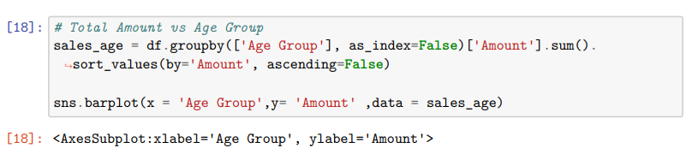
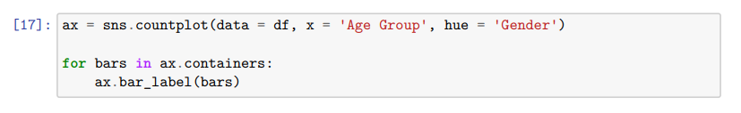
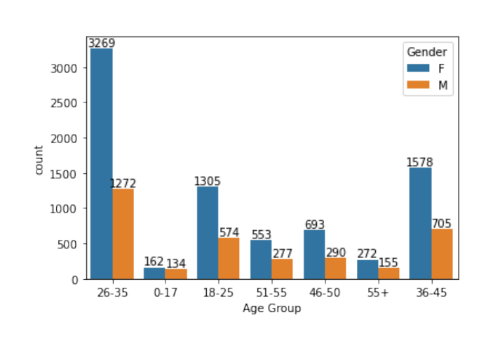
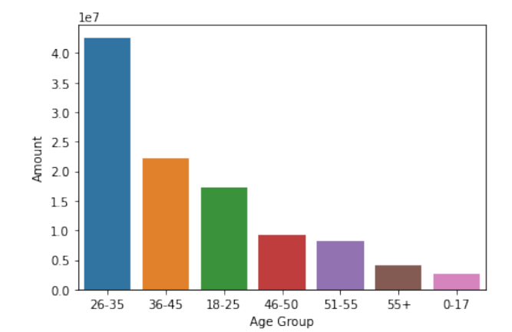
Age

Slide 10
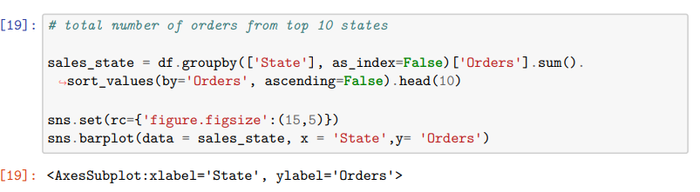
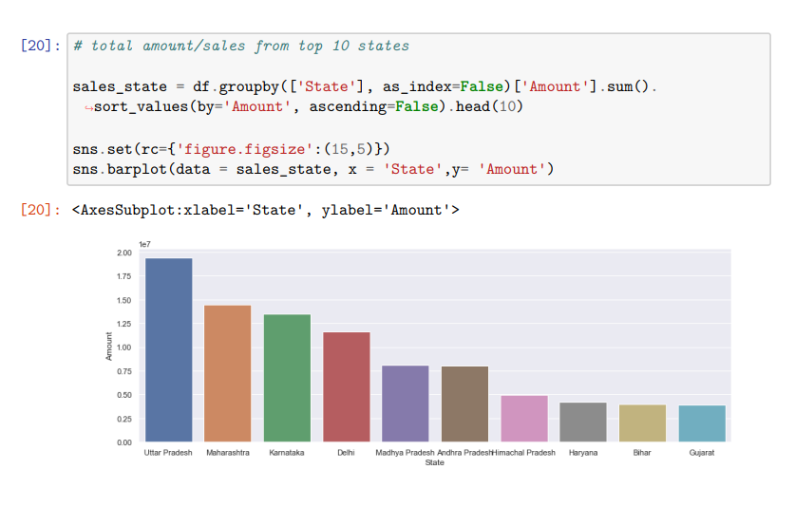
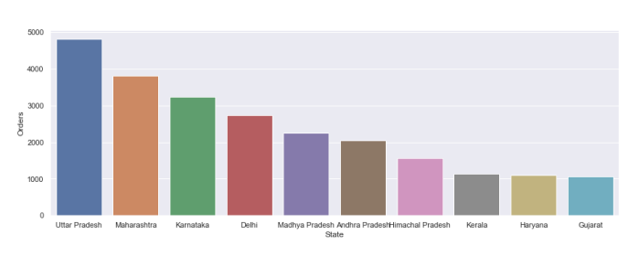
State

Slide 11
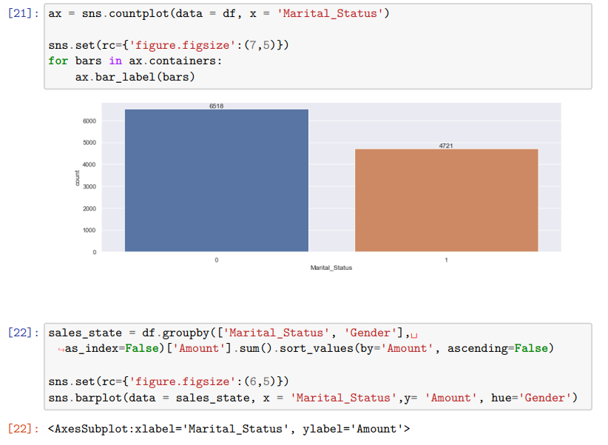
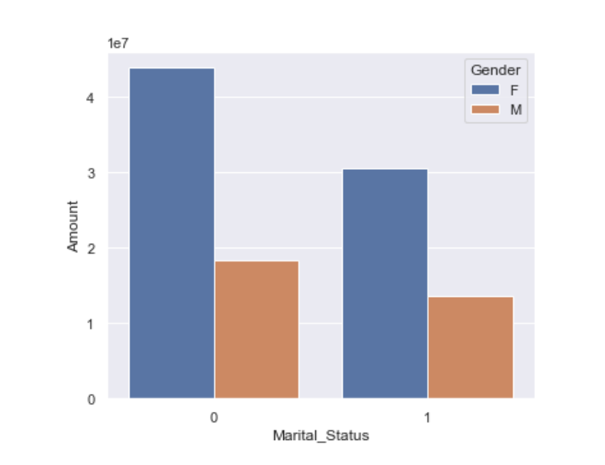
Marital Status

Slide 12
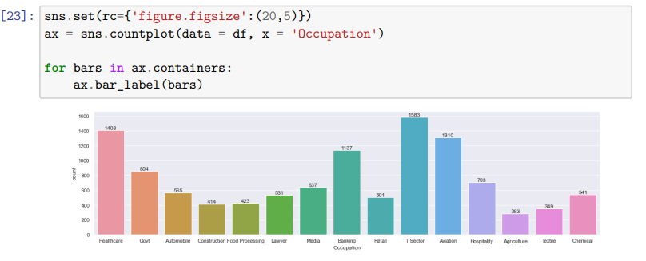
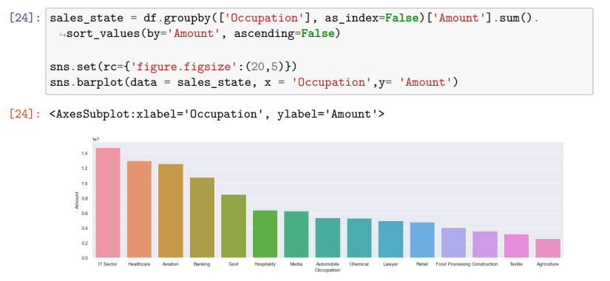
Occupation

Slide 13
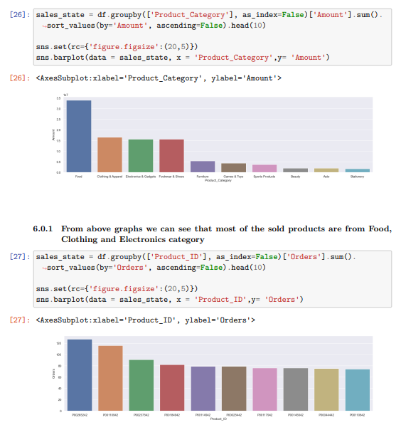
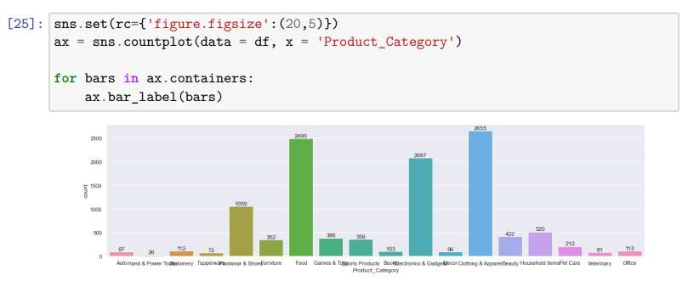

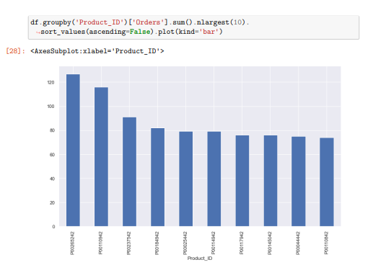
Product Category

Slide 14
Insights
The analysis of the provided data reveals several key insights about the consumer market. Firstly, the majority of buyers are females, with a greater purchasing power compared to men. Additionally, the largest proportion of buyers falls within the age group of 26-35 years, predominantly comprising females. Geographically, the states of Uttar Pradesh, Maharashtra, and Karnataka stand out as the regions with the highest number of orders and total sales/amount. Furthermore, the majority of buyers are married women who demonstrate a high purchasing power. Occupation-wise, the buyers predominantly work in the IT, Healthcare, and Aviation sectors. Lastly, the most popular product categories among buyers are Food, Clothing, and Electronics. These insights provide valuable information for businesses to tailor their marketing strategies, product offerings, and distribution channels to effectively target the female consumer base in these specific regions, particularly those employed in the mentioned sectors, and focus on product categories that align with their preferences and purchasing patterns.

Slide 15
Conclusion
Based on the information Married women age group 26-35 years from UP, Maharastra and Karnataka working in IT, Healthcare and Aviation are more likely to buy products from Food, Clothing and Electronics category.

